Slide 1
Training transformer LMs without backpropagation
Standard architecture at inference · equilibrium-propagation gradients in training · GPU now, analog next
Yuren Hao · July 2026 · technical primer

Slide 2
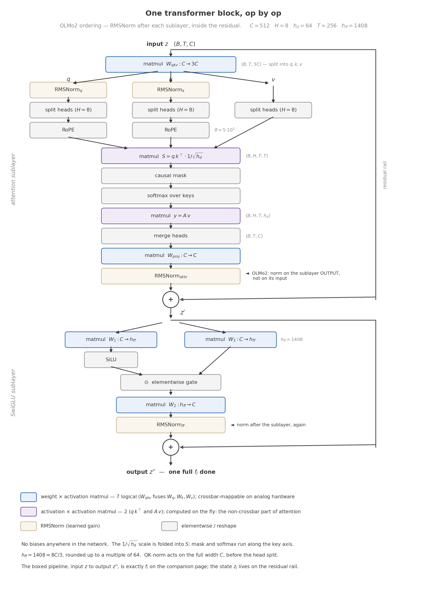
The model is a stock OLMo2 decoder — op by op
• Decoder-only transformer: L12, C512, H8, T256. RMSNorm, RoPE, QK-norm, SwiGLU, untied readout. No biases.
• Two trained instances: 42.75M (TinyStories, 4k BPE) and 72.11M (FineWeb-Edu, 32k BPE).
• Nothing in the inference graph is modified for our training method — the checkpoint is indistinguishable in form from a conventionally trained model.
• Color code, kept through the whole deck: blue = weight×activation matmuls (7 logical — crossbar-mappable on analog hardware); purple = activation×activation (qkᵀ, Av — must be computed on the fly); cream = RMSNorm; gray = elementwise.
• One honest architecture–method coupling: QK-norm and the final RMSNorm bound internal state scales, which the training estimator relies on. Both are stock components.

Slide 3
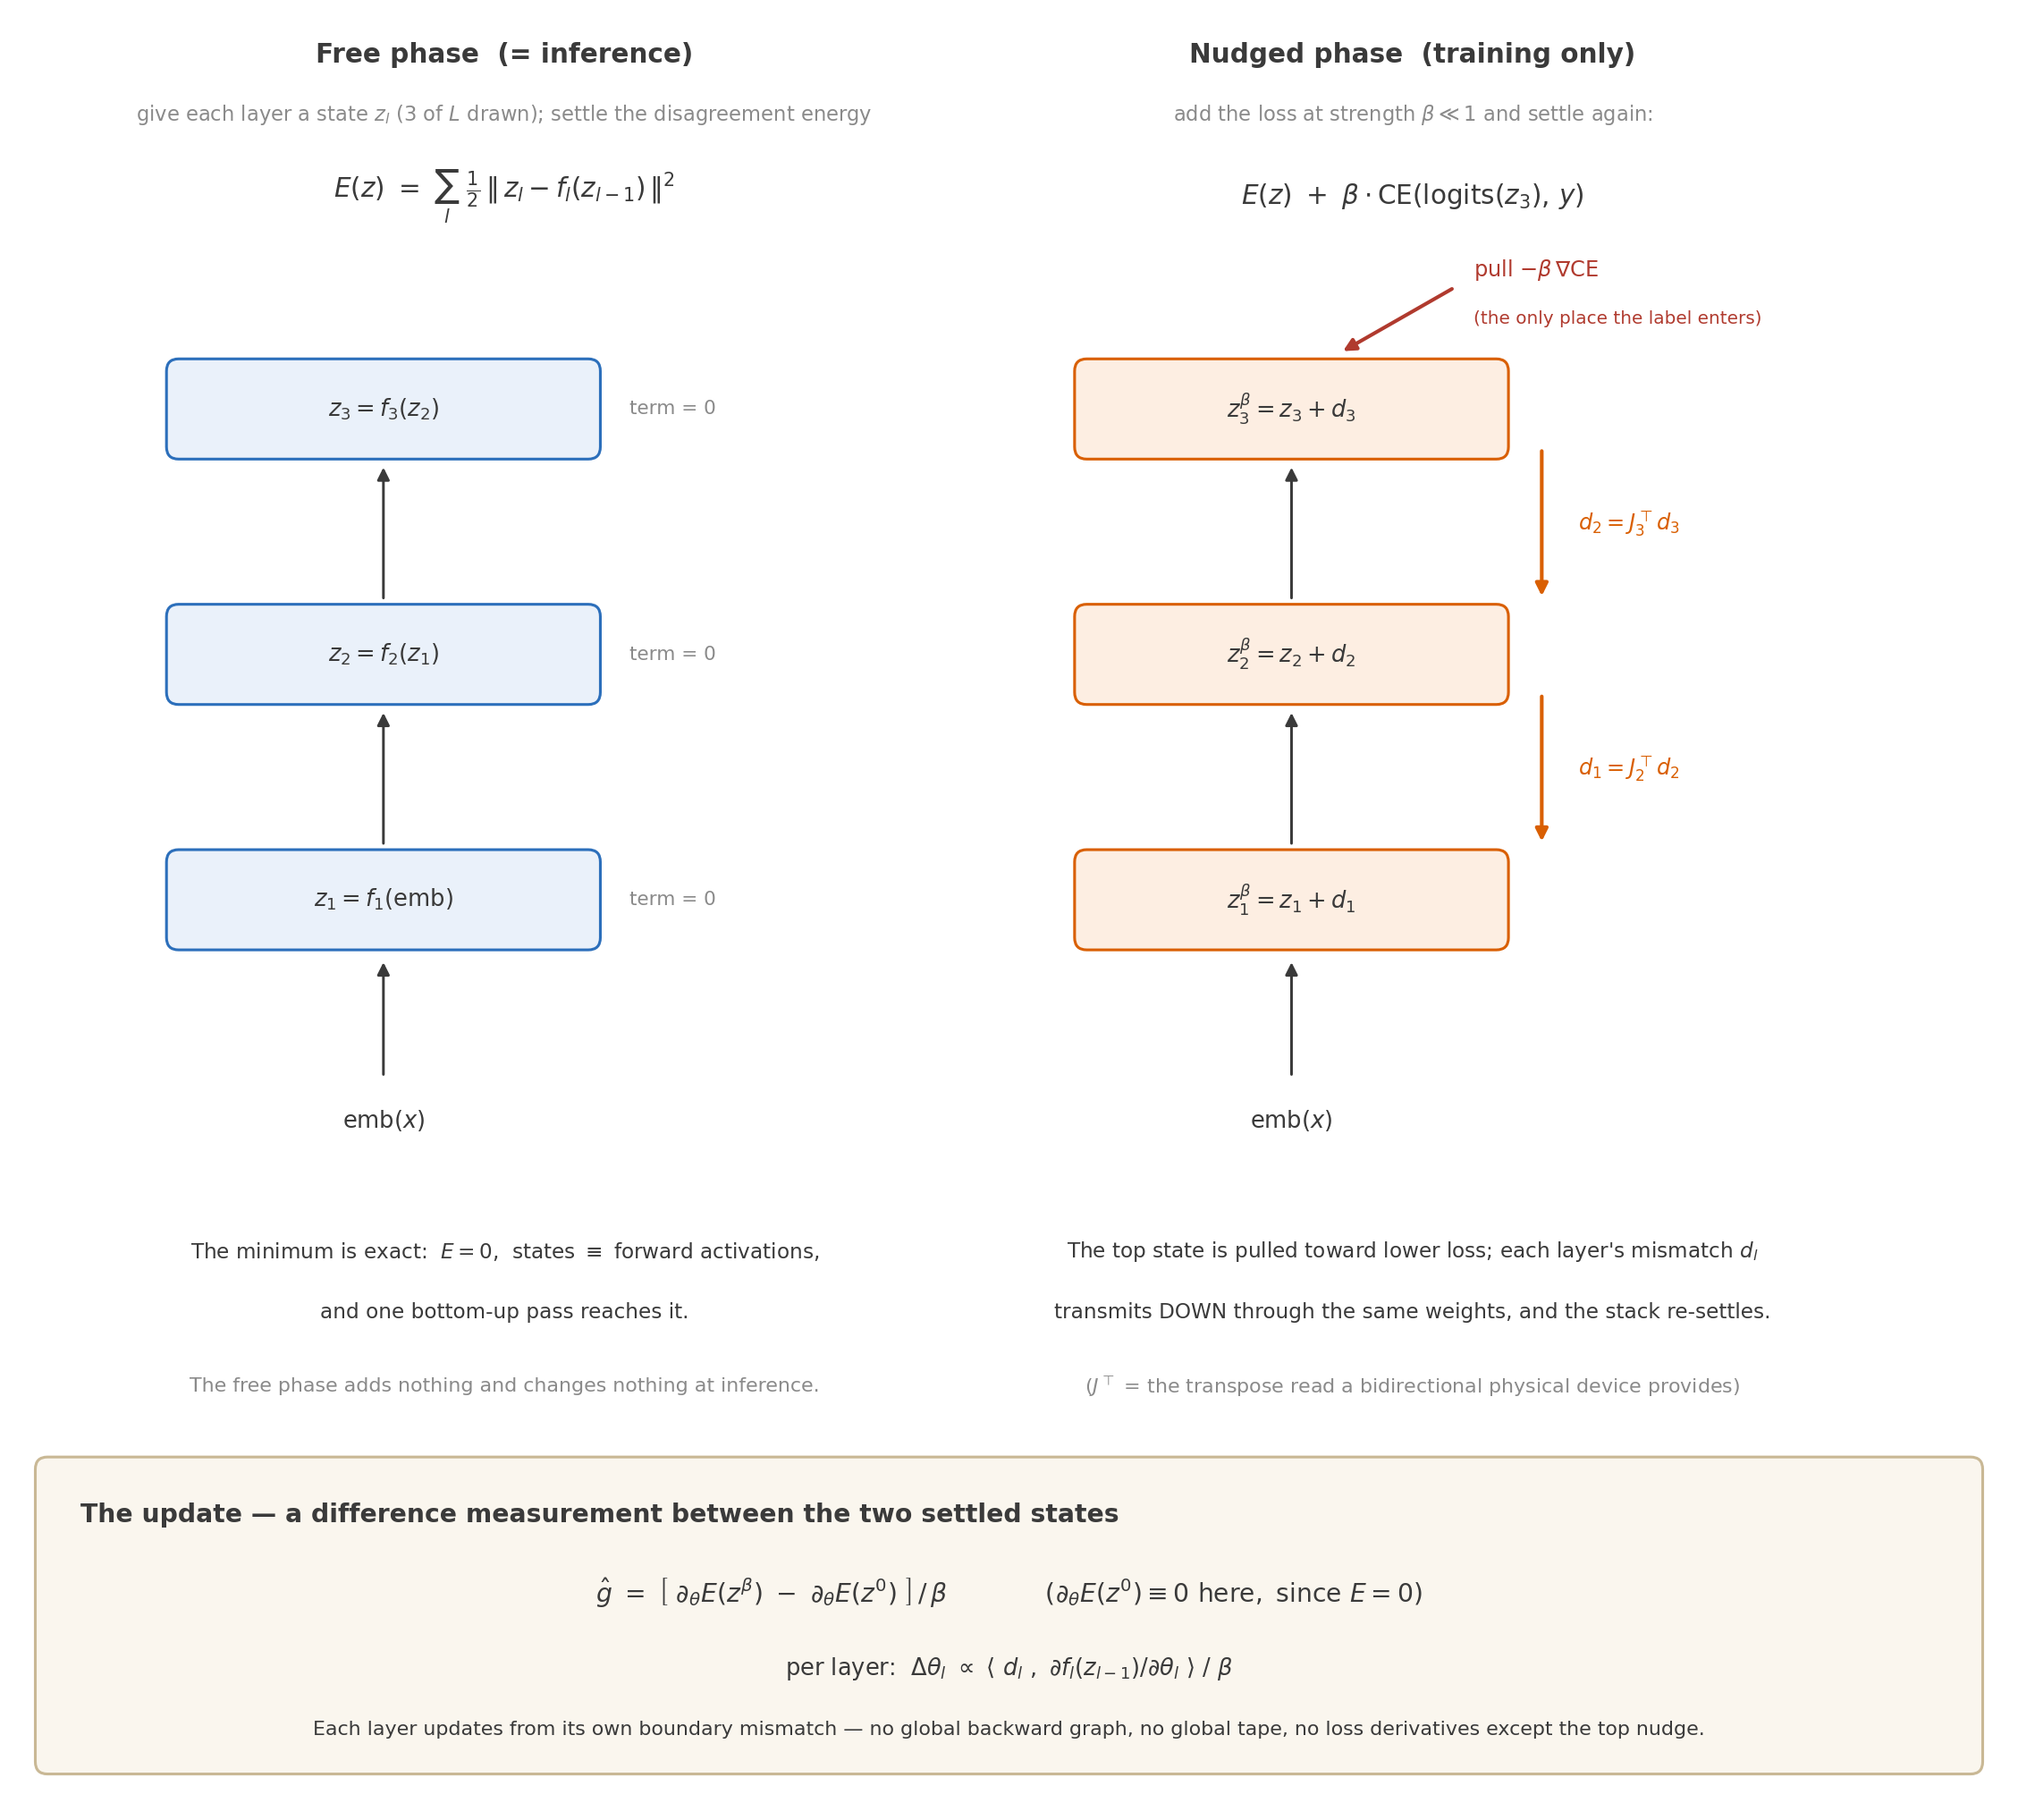
Training = two settles and a difference measurement
• The stack is treated as a system that settles: each layer gets a state zₗ, and the energy penalizes disagreement between zₗ and fₗ(zₗ₋₁).
• Free phase: settle with no label. The exact minimum IS the ordinary forward pass (E = 0). Inference is untouched.
• Nudged phase: weights frozen, states move — the loss pulls the top state with strength β, the whole stack re-settles, every layer picks up a mismatch dₗ.
• Update: states frozen, weights move — each layer absorbs its own mismatch: Δθₗ ∝ ⟨dₗ, ∂fₗ/∂θₗ⟩/β. Local quantities only; no global tape.
• The nudged state becomes the new free state: today’s pulled answer is tomorrow’s natural forward output.

Slide 4
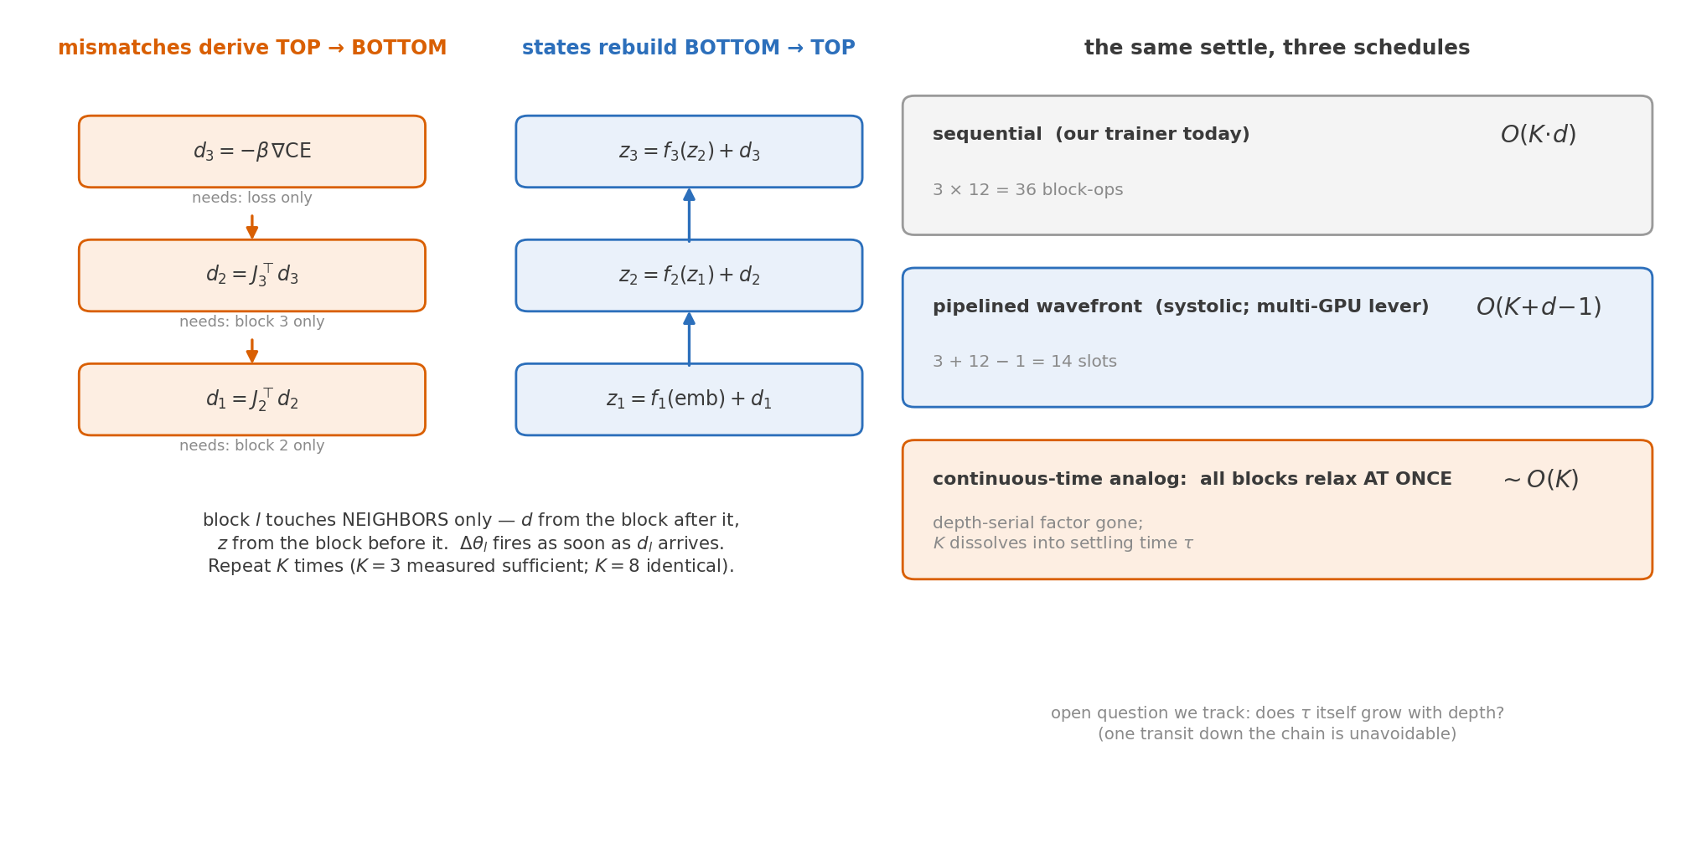
The update schedule: local, pipelinable — and native to physics
Everything that follows is the price of emulating this settle with discrete sweeps on a GPU. Two problems fall out — the physical system has neither.

Slide 5
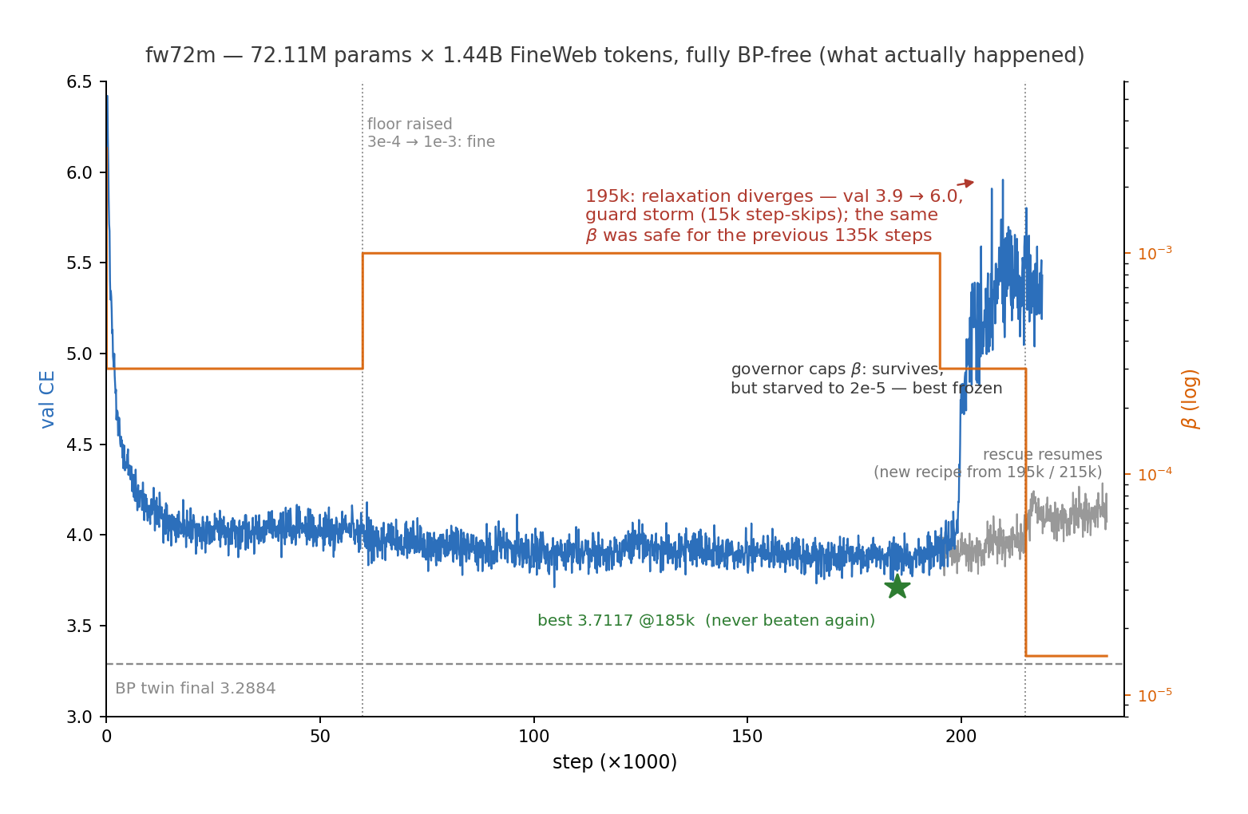
What actually happened at 72M (real run, real logs)
• Same β = 1e-3: safe for 135k steps, lethal at 195k. Something moved under the schedule.
• Guards contained it (15k step-skips, no NaN), a governor finished the token budget — but β starved to 2e-5 and best never improved after 185k.
• Headline stands: 72.11M × 1.44B tokens fully BP-free, best 3.7117 vs BP twin 3.2884.
• The 0.43 gap is a BLOWN-SCHEDULE number, not a method number. The honest rerun is in flight (last slide but one).

Slide 6
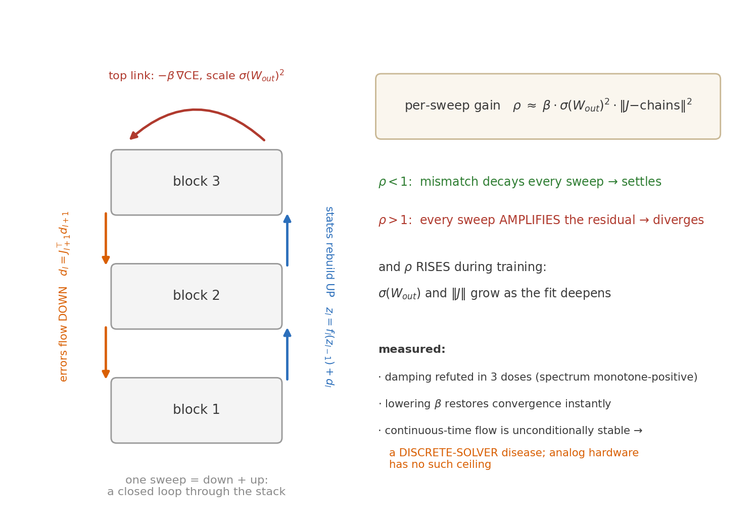
Problem 1 — the nudge closes a loop; discrete sweeps can amplify it
Why the SAME β became lethal: ρ ≈ β·σ(Wₒᵤₜ)²·‖J‖² crossed 1 as σ and ‖J‖ grew with fit depth.

Slide 7
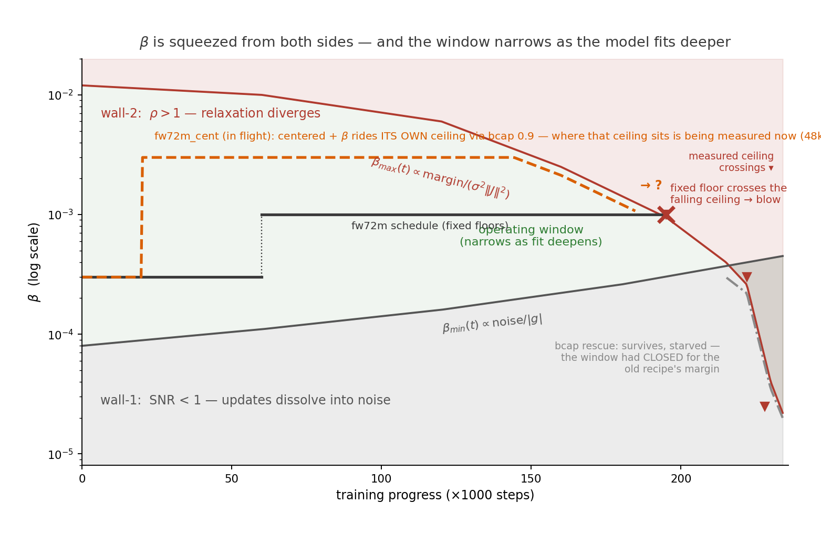
Problem 2 — β is squeezed from both sides, and the window narrows
• Floor is real and RISING: on the 42M testbed, tail at flat 1e-3 beats decaying to 3e-4 (1.2678 vs 1.2808). Momentum as a substitute for β refuted in 3 doses.
• Ceiling is real and FALLING: measured crossings at 195k (≤1e-3), 222k (≤3e-4), late (~2e-5).
• Window-aware recipe: centered ±β estimator (bias O(β²) → ride high) + a loop-gain governor capping β near ITS ceiling.
• fw72m_cent, in flight, is exactly this recipe.

Slide 8
Diagnostics already done (every number is a run you can open in wandb)
diagnostic | verdict
DDP gradient equivalence | cos 0.999999999 vs single-GPU big batch (manual all-reduce, synced guards)
centered + bf16 + DDP | cos 1.000000000 vs sequential centered; packed ±β variant identical (relerr 2e-5)
Error-source decomposition | within-block read EXACT (1.0000); ALL bias sits in between-block transmission (0.9987 = the whole EP deficit); K=1 degenerates to BP; K3 = K8 (converged, not truncated)
Wall-2 probes — 6 arms @72M | damping refuted in 3 doses; lowering β sails through; governor completes the budget
Tail-SNR arms — 7 @42M | centered@3e-3 wins CE and cos; ĝ-momentum refuted ×3; Richardson dominated; AdamW = tie
Gap-vs-size ladder — 8 runs, pre-registered | gap tracks FIT DEPTH, not width: 0.004 / 0.004 / 0.015 / 0.013 / 0.050 (C128→C512); C128 has gate cos 0.805 yet ZERO gap — direction noise alone costs nothing until the fit is deep
bf16 mixed precision | epoch-validated lossless (Δ +0.006), 1.56× wall-clock
Cost of centered | 1.72× step time (1.64× packed); tail-only switching amortizes to ~1.13×

Slide 9
In flight right now — and what the outcomes would mean
• stage1b_cent — 42M TinyStories, centered for the FULL epoch (at 30k/58.8k: best 1.3642, ahead of both originals at matched step).
• reads: best ≤ ~1.24 ⇒ the 0.050 gap was a noise-recipe account and the zero-gap line extends to C512 · 1.25–1.26 ⇒ a residual needs window management · >1.27 ⇒ an unknown term (falsifier).
• fw72m_cent — 72M FineWeb, the window-aware recipe from scratch (at 48k/234k: best 3.6890 — already below the original’s FULL-RUN best 3.7117, at 20% of the budget).
• registered predictions: no 195k-style blow; honest gap vs BP twin lands 0.25–0.35 (current trajectory suggests better).
• If both hold: the EP–BP gap is an ENGINEERING account — schedule + estimator — not an architectural tax. The frontier is late-phase signal-to-noise, and we hold validated levers for it.
• Queued next: 3 seeds at C256/C512 (certify the ladder tiers); the est-switch rule (when to start paying for centered); 300M × 6B.

Slide 10
How to spend the $50k — a laddered plan with kill-gates
rung | est. cost | what it buys | gate to the next rung
300M × 6B tokens (rented H100, days) | ~$0.3k | recipe + window governor at 4× params; DDP at scale | gap & stability hold
1B × 10B | ~$5k | first B-class BP-free LM; the LAST affordable BP twin | gap ≤ target at 1B
7B × 20B (flagship) | ~$30k | headline result; compare to published baselines (no twin) | —
reserve | $10–15k | seeds, reruns, ablations, surprises | —
Prices (sourced, July 2026): market H100 $1.87–2.99/GPU·h; AWS p5e $4.97/GPU·h. All estimates include bf16 (1.56×) and EP ≈ 3.2× BP wall-clock; tail-only centered adds ~1.13×.
Alternative one-shot: 3B-Chinchilla ≈ $40k fits the envelope alone — but the ladder buys three publishable points and de-risks the flagship.

