Slide 1
Training LLMs Without Backpropagation in Analog Hardware
Progress update · June 30 – July 14
Yuren Hao · July 14, 2026
Notes:
Two weeks since last meeting; three big things: the result, the sponsor, the scale plan.

Slide 2
Since we last met — three headlines
RESULT — a standard 12-layer transformer LM trained end-to-end with NO backpropagation,
  0.05 nats from a tuned backprop control over a full epoch; generates coherent text (1-click demo notebook).
SPONSORS — two founders of the field engaged: Benjamin Scellier (EP co-inventor; ~$50k AWS compute
  + active technical collaboration) and Sam Dillavou (Penn; processor-free learning hardware — hardware side).
SCALE — 300M x 6B tokens queued this week on a free NCSA Delta allocation;
  1B fully costed at ~$5k; the $50k envelope reaches 3B-Chinchilla or 7-8B.
Notes:
Each headline gets its own slides below.

Slide 3
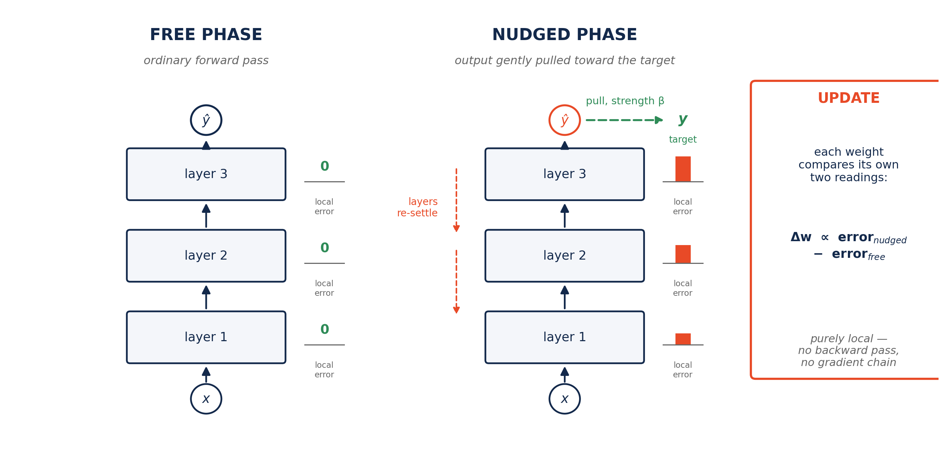
How it works: two settles and a local comparison
Inference ships as the FREE phase alone — an ordinary forward pass, deployable like any LLM. Training needs no backward pass — which is exactly what analog hardware can implement.
Notes:
Walk the figure left to right: free settle (errors zero), nudge beta, re-settle, per-weight local comparison. If asked "is the transpose read backprop": no global backward graph exists; each exchange is between adjacent layers only — on hardware it is the same resistor read from the other terminal.

Slide 4
Headline result: near-zero gap over a full epoch
 | val CE (TinyStories) | note
EP (ours), 4k steps, 3 seeds | 1.7314 ± 0.012 | statistically = BP
BP control, 4k steps | 1.7098 | tuned, same arch
EP, full epoch (59k steps) | 1.2808 | 0.050 nats behind
BP control, full epoch | 1.2311
Model output (unedited):
"Once upon a time, there was a little girl named Lily. She loved to play outside in the sunshine. One day, she was playing with her ball when she accidentally threw it too hard and it went into the street. Lily ran to the street and saw a big, angry dog. [...] Lily learned that sometimes things that seem scary can also be friendly."
42.75M params, OLMo2-style architecture, 361M tokens.
Residual gap mechanism identified (estimator signal-to-noise vs
precision floor) and mostly removed by a beta-schedule.
Notes:
Sample is from the actual checkpoint (val 1.2808). OFFER LIVE DEMO: the a1 notebook generates in ~30s. If asked why 4k has no gap but epoch does (late-SNR, 30s): EP reads the gradient from the DIFFERENCE of two settled states; that difference is proportional to beta x the true gradient. Late in training the true gradient shrinks, so the difference sinks toward the floating-point noise floor - the estimator loses SNR exactly when the model is nearly done. Like measuring a slope from two nearby probe points: as terrain flattens, the height difference drops below instrument precision; the fix is to step further apart - keep beta from shrinking (floor/ramp). Causal check: raising the floor moves gradient cosine 0.975->0.990; this closed the gap 0.22->0.05. If asked why not large beta from the start: early on the true gradient is large, small beta means less bias - beta is scheduled against SNR, not constant.

Slide 5
Why this is a first
Claims verified against the literature
system | scale | actually backprop-free? | gap vs BP
Optical DFA (2024) | 1.07B | no — trains 400M, BP kept at readout | —
Evolution strategies / EGGROLL (2025) | billion-class | fine-tuning only (pretrain is BP) | behind BP (unreported)
Kerjan–Høier–Scellier (2026) | 62.7M VGG (vision) | yes — full EP | 1–1.5 pp; 6.7–12x wall-clock
Ours (2026) | 42.7M transformer LM | yes — zero BP anywhere in training | ~0; 3.2x FLOPs
To our knowledge: the first transformer / autoregressive language model fully trained without backpropagation —
and the only approach in this family reporting a near-zero quality gap.
Notes:
KHS is Scellier's own group — vision, with a real gap; that is why our zero-gap LM interested him.

Slide 6
Sponsorship: Benjamin Scellier
Co-inventor of Equilibrium Propagation; Rain AI
Who: co-invented Equilibrium Propagation (2017, with Bengio); now at Rain AI (analog-AI hardware).
How it happened: cold outreach with our report -> his detailed technical review ->
  a correction cycle (he challenged a claim; we answered with a one-page proof note, now a joint-appendix candidate) ->
  he offered compute: ~$50k on AWS for the scaling program.
Current state: shared Overleaf he actively comments on; a joint appendix under discussion;
an active technical email thread.
Signal: the founder of the field is engaged — potential senior collaborator on the scale paper.
Notes:
His review was blunt (called LLM-drafted parts out); the working relationship is healthy and technical.

Slide 7
Scaling: economics and readiness
Every number measured on our runs or a live queue probe
run | AWS | market
300M x 6B (validation) | ~$500 | ~$300
1B x 20B Chinchilla | ~$5k | ~$2.5k
3B x 60B Chinchilla | ~$40k | $18-27k
7B x 20B (GPT-3 style) | ~$30k | $14-21k
Readiness (this week):
  mixed-precision training validated — lossless, 1.56x faster
  multi-GPU training built; gradient equivalence verified to cos = 0.999999999
  FineWeb-Edu pipeline: 10.5B tokens, 32k tokenizer — smoke test passed
  NCSA Delta allocation: 9,829 free GPU-hours; 300M x 6B queued this week
The $50k envelope reaches 3B-Chinchilla OR 7-8B
(after the 1B milestone).
Notes:
Every number on this slide is measured on our runs or a live queue probe, not estimated.

Slide 8
Analog-hardware track (brief)
Every operation in the recipe was chosen to have a known analog circuit implementation.
Measured fault-injection tolerances: the ONLY hard requirement is ~7-bit effective weights;
  10% noise on the learning signal is FREE, 1% forward noise is FREE — learning co-adapts to the device.
A $300 clockless "physical learning tile" MVP is designed (replacing a $5-20k CIM demonstrator).
Sam Dillavou (Penn — built the processor-free learning network our tile descends from) responded
  with strong praise; working session in ~2 weeks (he is traveling). UIUC (the CIM rung) is next — see asks.
Notes:
Dillavou = the physical-learning tile collaborator; Shanbhag = the CIM rung - the two asks are complementary, not redundant. Dillavou syncs with us in ~2 weeks.

Slide 9
The dynamics paper — one-slide summary
The other half of the work, now the theory companion
Question: when networks compute by settling to equilibrium, training itself can destabilize the settling —
the resting point stops being restful and turns into a sustained oscillation. When, and what does each safeguard cost?
Result: the mechanism of that transition, pinned down and verified; and a control map of every published
protection (what quantity it clamps x when its signal acts), 200 seeds per cell, each with a measured cost.
Relevance to the LLM line: our energy-based training lives in the provably-benign class — the paper explains
WHY the LLM needed no safeguards. Scellier reviewed it: "interesting and useful."
Notes:
Keep to 90 seconds. If he digs: the transition is a Hopf bifurcation, certified via the first Lyapunov coefficient - but do not lead with the term.

Slide 10
Why I am taking this seriously
Publication strategy — input welcome
If this works at scale, it is not an ML-methods result: training without backpropagation on physical
hardware opens research directions across AI, electrical engineering, materials science, and physics —
new devices, new circuit primitives, and a different economics of training.
It now has real support: compute funding (~$50k), and leading experts engaged on both the algorithm side
(Scellier) and the physical-hardware side (Dillavou).
So the plan: two papers — the dynamics/theory paper first as the foundation, and the scale demonstration
aimed at the most general venue the final result supports.
Open for discussion: two papers vs one; when to preprint; authorship structure with industry collaborators.
Notes:
"Most general venue" = Nature-class if the hardware demo or 7-8B lands; say it out loud only if he asks. Zhai has venue calibration - genuinely solicit his read on sequencing and preprint timing.

Slide 11
Asks
1. A warm intro to Prof. Shanbhag's group (in-memory-computing / mixed-signal) —
  the "transformer block on silicon" phase needs exactly their substrate; one email from you
  lands very differently than a cold one from me. (Draft + one-page brief are ready.)
2. Venue-strategy advice on the two-paper plan.
3. Fall logistics: research credit / time allocation for this project.
Notes:
The Shanbhag intro is the highest-value ask; the brief and email draft exist — he only forwards.

Slide 12
People
Confirmed · likely · future outreach
 | Dynamics side | LLM side | Hardware side
Confirmed | [name — role] | [name — role] | [name — role]
Likely / in discussion | [name — status] | [name — status] | [name — status]
Future outreach | [name — hook] | [name — hook] | [name — hook]
Notes:
TEMPLATE — fill names per column/tier before presenting.

