Slide 1
Somato-Dendritic Innovation Learning
Local credit assignment from soma-unpredicted dendritic signals
Inspired by the neuron-specific somato-dendritic residuals reported by Francioni et al., Nature 2026
Question: should a local learner use apical activity itself, or the component that is unexpected from the same neuron's somatic state?
Project overview · August 2026

Slide 2
From the biological observation to a local learning rule
2
The Harnett-lab study fits each neuron's normal soma–dendrite relationship. The residual is decorrelated from soma and carries outcome and signed task information.
aₗ = sₗ + nₗ
âₗ = Pₗ(hₗ)
rₗ = aₗ − âₗ
mixed apical activity
neutral-period prediction
somato-dendritic innovation
ΔWₗ = η (rₗ ⊙ φ′(uₗ)) hₗ₋₁ᵀ
presynaptic activity × local postsynaptic gain × dendritic innovation
• Training uses locally available quantities, forward observations, and manual synaptic updates.
• Node-perturbation feedback supports the small-network experiments; reciprocal Kolen–Pollack plasticity supports the standard ResNets.
• The inherited credit path transports layer-specific directions. SDIL removes soma-predictable traffic from those directions.
Sources: Francioni et al. (Nature 2026); Lansdell et al. (ICLR 2020); Akrout et al. (NeurIPS 2019).

Slide 3
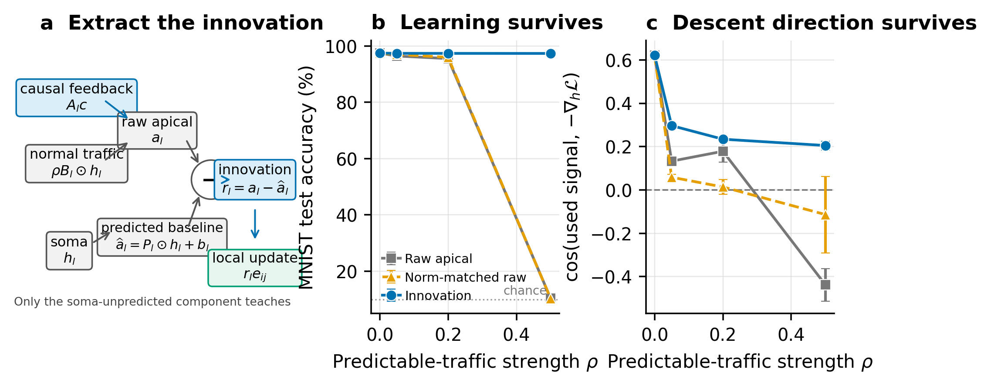
Residualization is load-bearing under predictable traffic
3
Controlled MNIST intervention · depth 3 · width 256 · five paired seeds
At traffic strength ρ = 0.5: raw 10.38%, norm-matched raw 10.31%, innovation 97.35%.
Norm matching equalizes per-example update magnitude. The remaining difference comes from teaching direction.

Slide 4
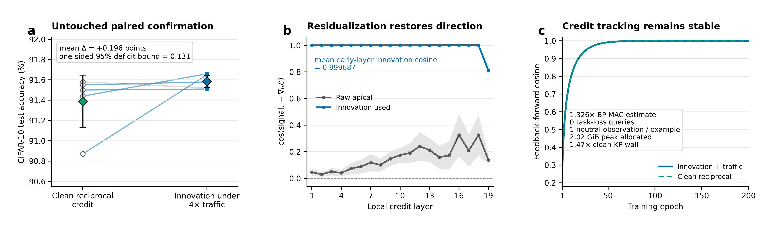
Dynamic innovation survives a standard ResNet-20 test
4
CIFAR-10 · 200 epochs · five untouched paired seeds · four-times-RMS soma-predictable traffic
• Dynamic SDIL under traffic: 91.584% mean test accuracy; clean reciprocal KP: 91.388%.
• Mean early-layer teaching-signal cosine: 0.999687.
• Cost: 1.326× the matched BP MAC estimate, zero task-loss queries, and one neutral observation per example.
Exact gradients serve diagnostic measurement; local signals drive every learning update.

Slide 5
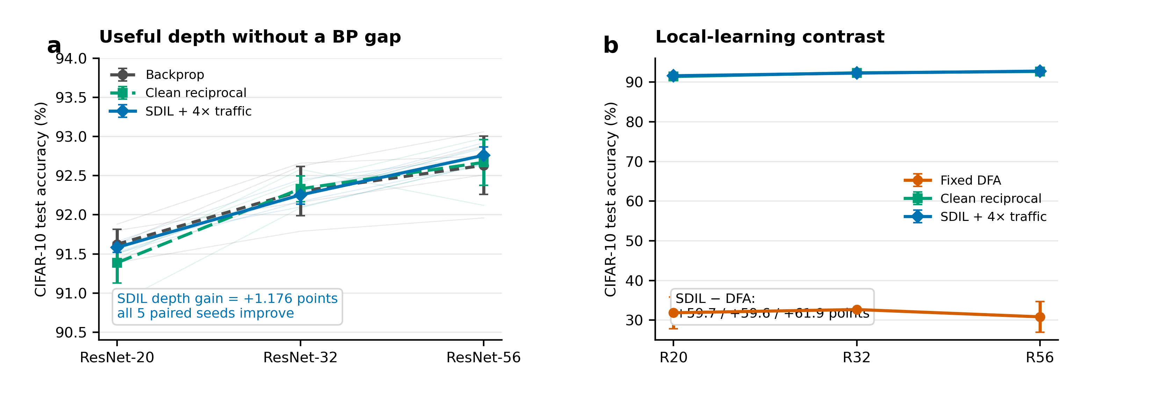
Scaling from ResNet-20 to ResNet-56
5
Complete 60-endpoint CIFAR-10 panel · five seeds per method and depth · shared hyperparameters
SDIL under 4× traffic: 91.584% → 92.254% → 92.760%; all five R20/R56 pairs improve.
Reciprocal KP provides the scalable credit path. SDIL preserves this path under mixed apical traffic.
BP and clean reciprocal KP follow the same depth trend; fixed DFA remains near 31%.

Slide 6
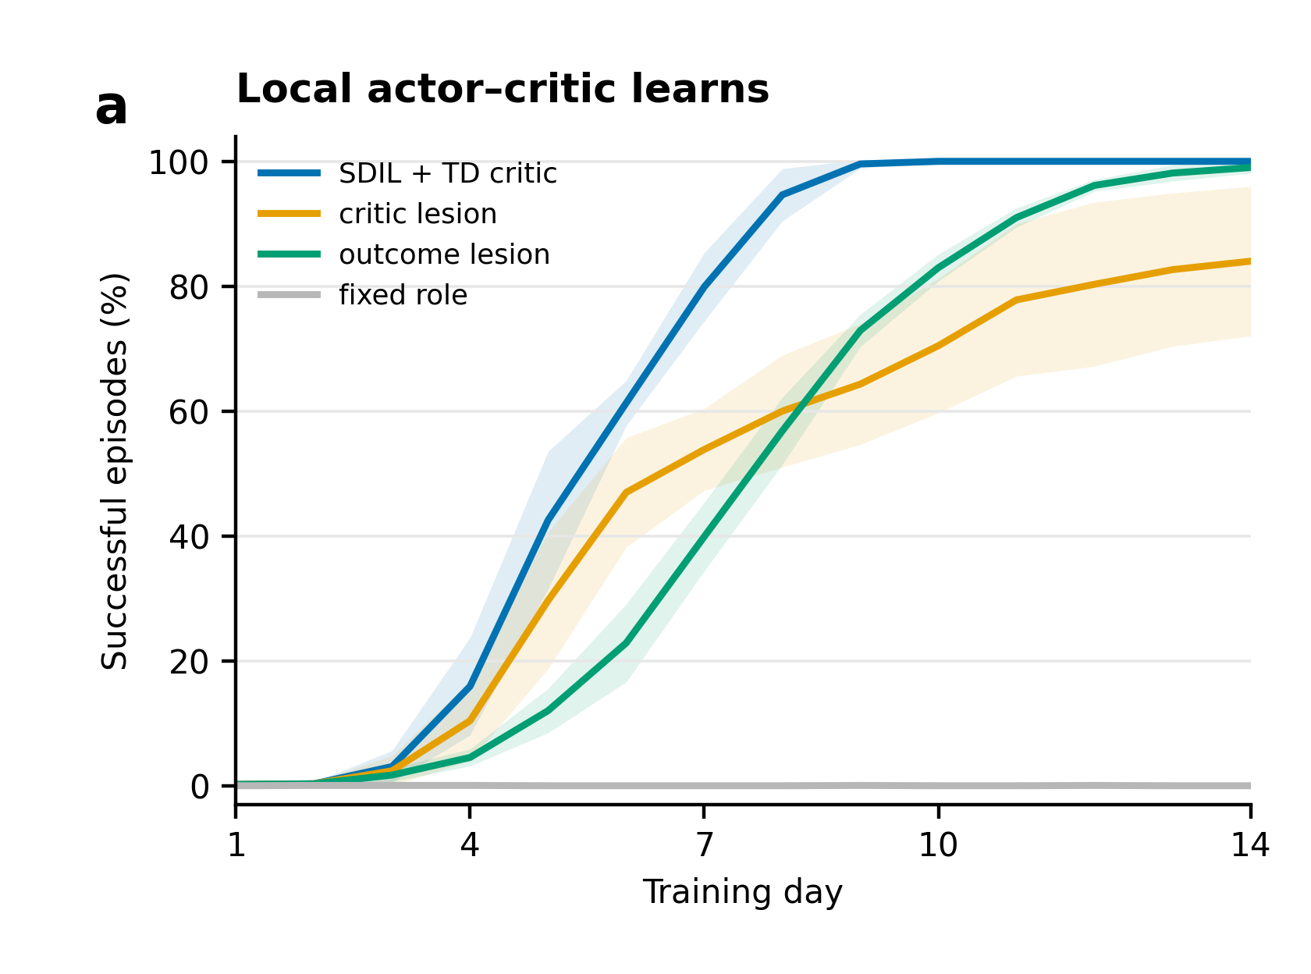
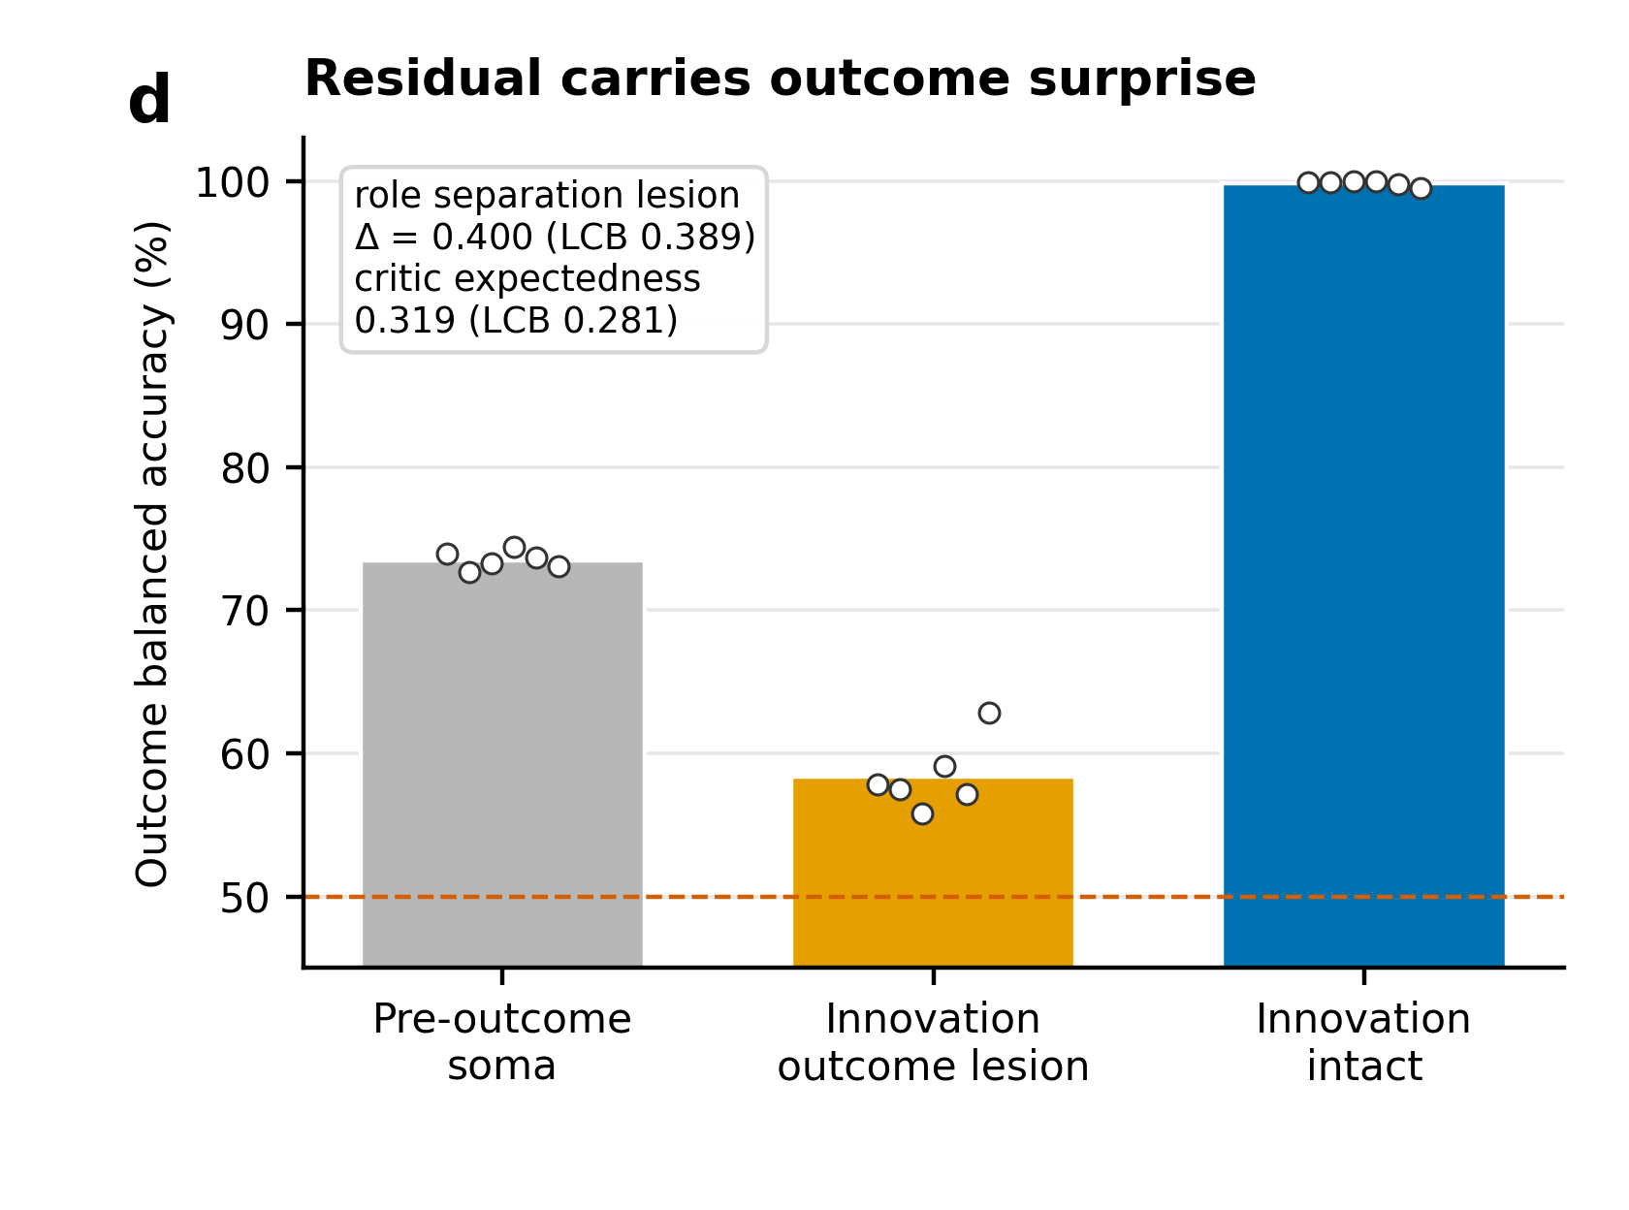
A local actor–critic produces temporal outcome signals
6
Synthetic BCI task · six task clusters × five model seeds · manual local updates
Final success: 100% · terminal outcome decoding: 99.83% · outcome-lesion effect: 0.400.
The synthetic task supplies terminal reward and tests neuron-specific outcome surprise with causal lesions.
Outcome labels and exact causal roles serve evaluation.

Slide 7
Current scientific position
7
Established
• Soma-predictable apical traffic can rotate a raw local teaching signal.
• Per-neuron innovation preserves learning direction under controlled traffic.
• Dynamic innovation works with a scalable BP-free reciprocal credit path on ResNet-20/32/56.
• A separate local actor–critic reproduces neuron-specific outcome signaling in a controlled dynamical task.
Attribution
• Reciprocal KP provides clean-setting scale and feedback tracking.
• SDIL provides soma-conditioned traffic removal and the associated mechanism tests.
Next decisive experiment
Evaluate raw reciprocal credit and SDIL under naturally generated, state-dependent mixed traffic with component-level bias hidden from the learner.
Target claim: scalable local credit assignment with adaptive removal of predictable feedback contamination.

